Slide 1

Introduction to
Oxy-Fuel Technology
By Mr. V. B. Mahendra

Slide 2
Conventional Combustion v/s Oxy-Fuel
Traditional Combustion
  Air fuel fired 21% oxygen, 79% nitrogen
  3 to 5% excess air
Relatively Low Flame Temperature
Readily Available Nitrogen to Create NO_{X}
Nitrogen Increases the combustion volumes
78% Potent heat escapes through Stack.
Higher Flame temperature
No change in furnace design and materials
Possibility of variable processes
No change in versatility of the usage
Does not affect Inclusions/impurities in the re-melted aluminum
No change in dross generation
No change in the yield
<number>

Slide 3
Jupiter - Encon Solution
Maximizing energy transfer, radiation and increased residence time
Properly designed combustion system
Maintaining existing process variables
Stoichiometric ratio
Reduce energy input to match efficiency increase
More economical if you have your own oxygen plant
<number>

Slide 4
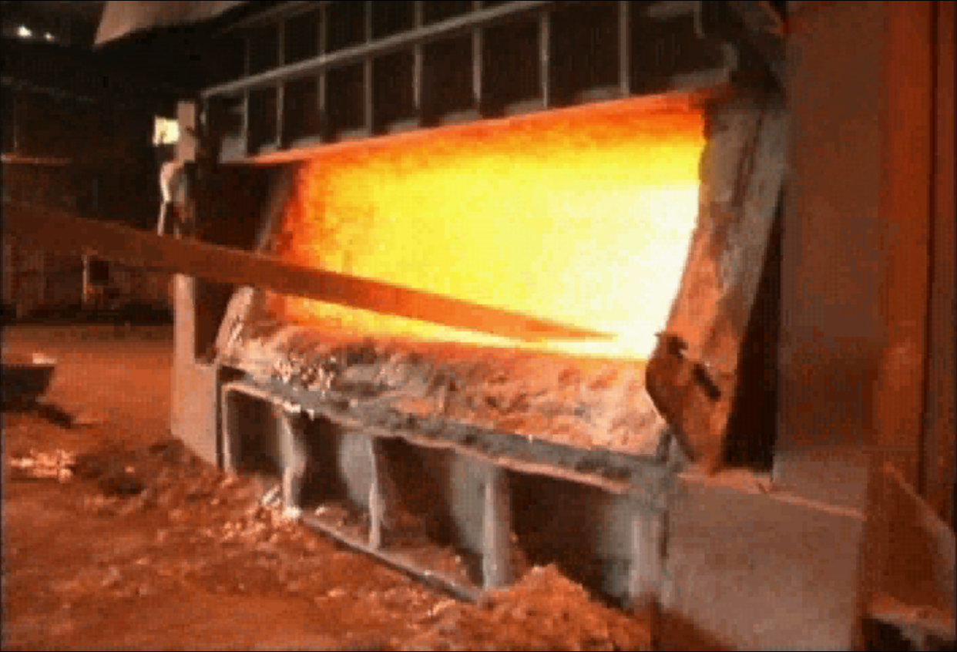
Jupiter’s technology…
is a patented process for the combustion of fossil fuels with pure oxygen
uses an undiluted high flame temperature, but keeps the same process temperatures
combusts at or near stoichiometric
retrofitted using the same furnace design and refractories
<number>

Slide 5
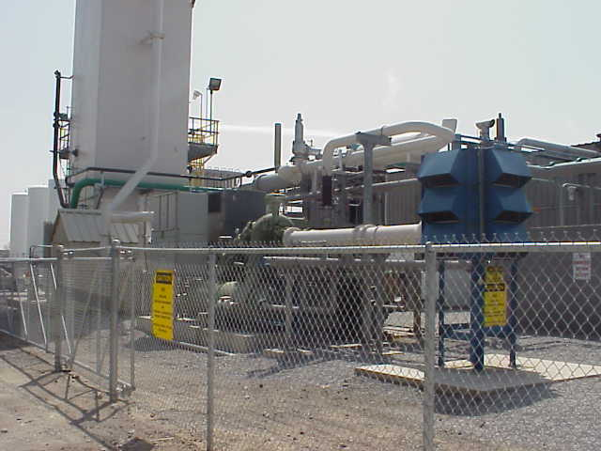
Aluminum Applications, Best Practice & Benefits
Secondary Aluminum
Re-melting & Holding furnaces
Dross Recovery
Co Production
  Nitrogen
  Argon
Alumina Calcinations Processing
Power Generation
<number>

Slide 6
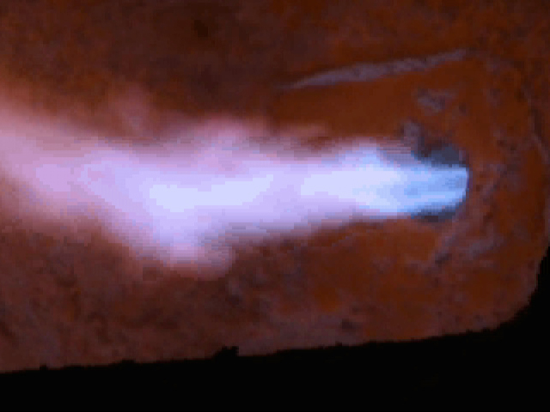
Results with Aluminum Melting
Improved Energy Efficiency
417 – 500 Kcal / Kg for continuous runs
Elimination of airborne nitrogen
More radiant heat transfer
Longer gas residence time
Lower Fuel Costs
Natural gas fuel reduction up to 73%
Oil fuel usage reduction up to 68%
Improved Production
Better heat transfer
<number>

Slide 7
Results with Aluminum Melting
 | Estimated | Production FCE
Year | Casted Aluminum | Natural Gas | Waste Oil | Waste Oil | Percent | CO2 - Oil | CO2 - NG | CO2
 | Tonnes | MNkCal | MNkCal | Litres | Oxy-fired | TPY | TPY | TPY
1997 | 61,144 | 1,52,553 | 0 | 0 | 0.00%
1998 | 74,409 | 1,43,656 | 0 | 0 | 26.90% | 0 | 32,001 | 32,001
1999 | 82,548 | 1,11,321 | 0 | 0 | 46.00% | 0 | 24,798 | 24,798
2000 | 83,813 | 1,01,004 | 0 | 0 | 53.50% | 0 | 22,499 | 22,499
2001 | 73,159 | 31,504 | 21,298 | 23,19,228 | 100.00% | 5,930 | 7,018 | 12,948
<number>

Slide 8
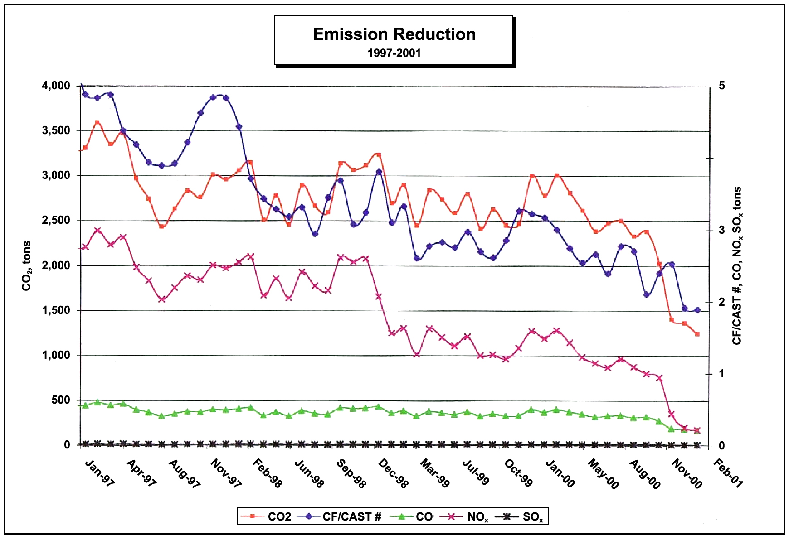
Results with Aluminum Melting
Usage of Oxy-Fuel at
Jupiter Aluminum Corp.
1997: 0%
1998: 27%
1999: 46%
2000: 54%
2001: 100%
<number>

Slide 9
Carbon Markets & Environmental Funds
Mandatory Carbon Market
  CDM Project Development
Carbon Partnership Facility (CPF)
  The World Bank’s new Strategy
  Sectoral approach & large scale
  Longer term [10+years after 2012]
  Catalyze clean technology investment
  Bride the inaugural costs of clean
  technology investment
Environmental Funds, UNFCCC
  GEF Global Environment Facility
    World Bank Group
<number>

Slide 10
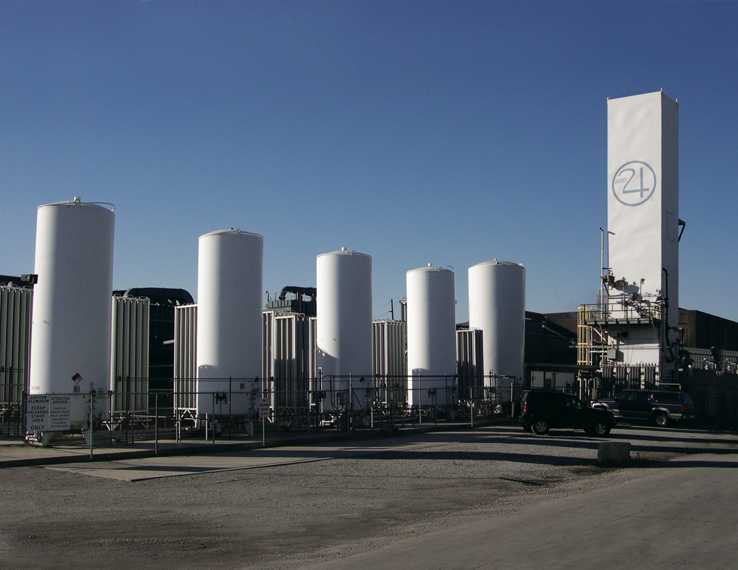
Contact Information
JUPITER OXYGEN CORPORATION- USA
4825 N. Scott St., Suite 200
Schiller Park, Illinois 60176 USA
fax 001.847.928.0795
www.jupiteroxygen.com
Encon Thermal Engineers - INDIA
297 Sector 21B, Faridabad 121001, Haryana
Ph. : +91-129-129 4047847, 4041185
Fax : +91-129-4044355
Email sales@encon.co.in
www.encon.co.in
<number>

