Slide 1
ENCON THERMAL ENGINEERS
…Answer to the Continued Need for Energy Conservation

Slide 2
DESIGNING OF EFFICIENT FURNACES AND OVENS
By:
Mr. V.B Mahendra

Slide 3
TRADITIONAL OVENS
Fabricated
Electric heating / Thermic Fluid / Hot air generator
Rock Wool Insulation

Slide 4
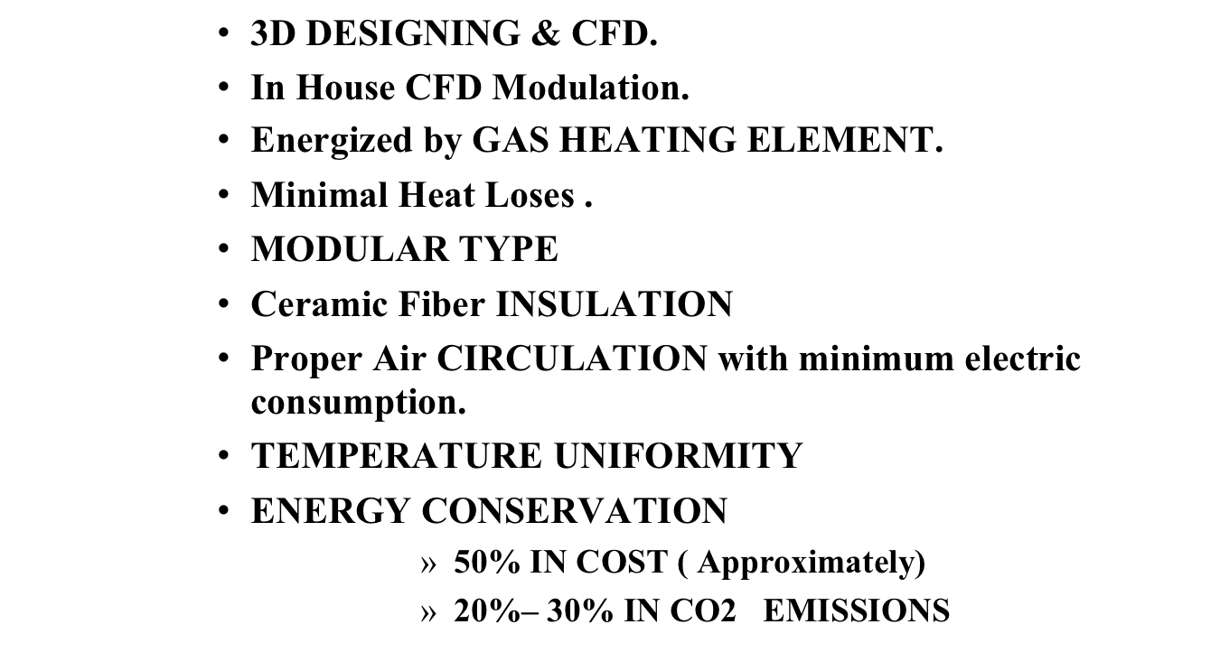
OVENS BY ENCON

Slide 5
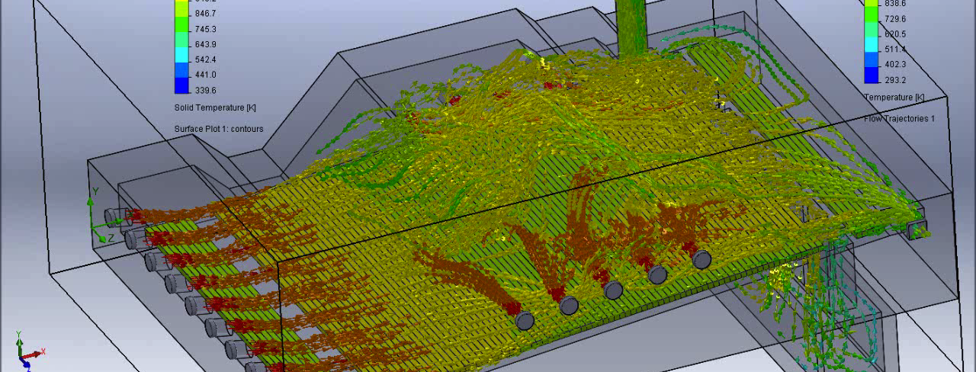
CFD OF FURNACE

Slide 6
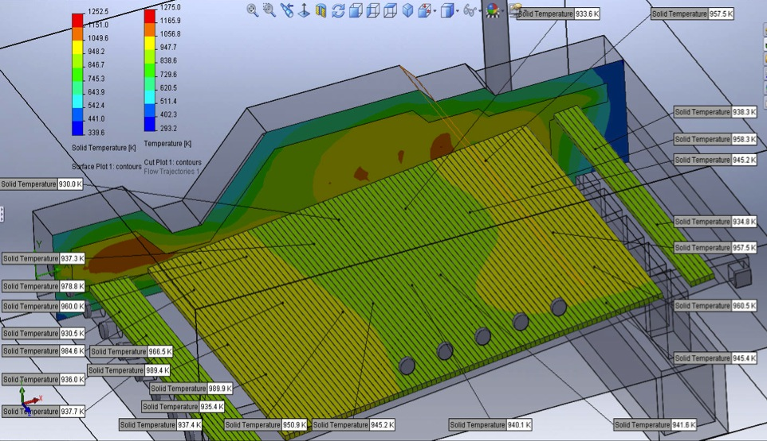
RESULTS OF CFD
ANALYSIS

Slide 7
OVEN MADE BY ENCON FOR AREVA

Slide 8
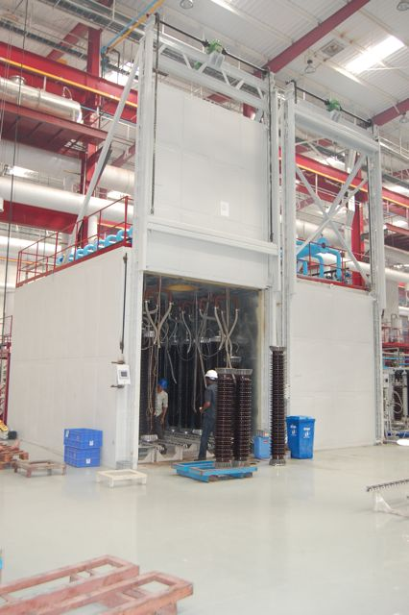

Slide 9
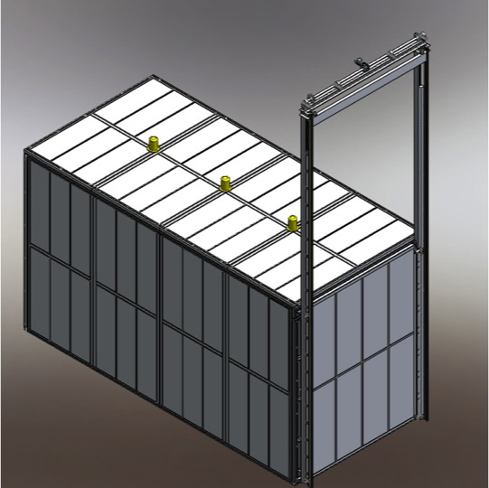

Slide 10
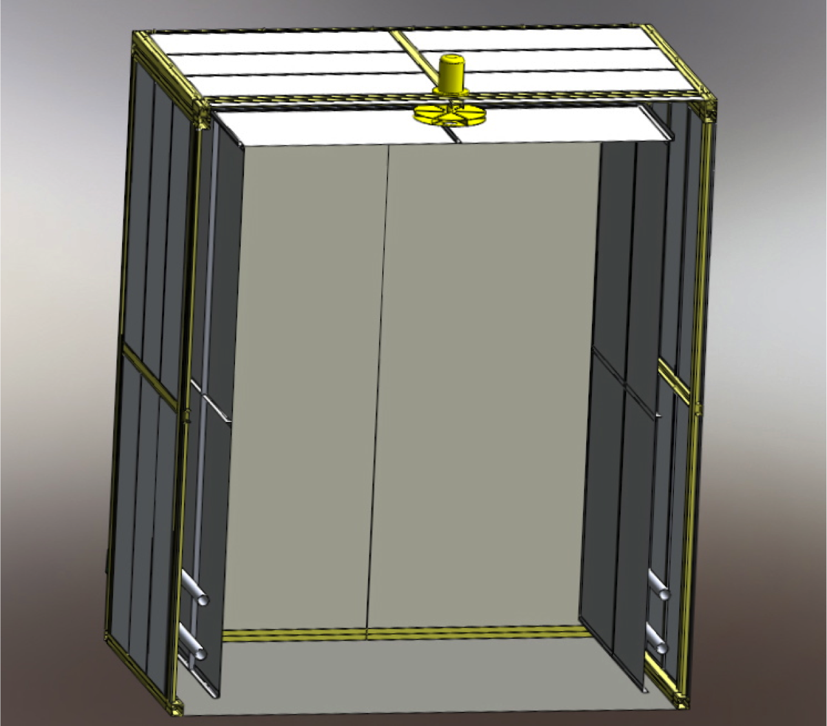

Slide 11
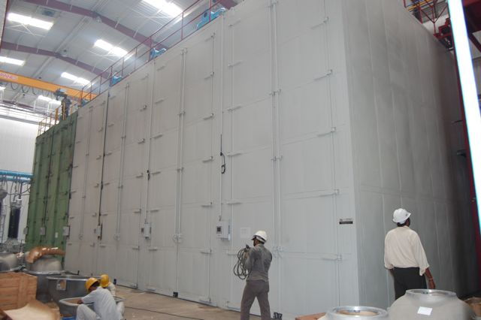

Slide 12
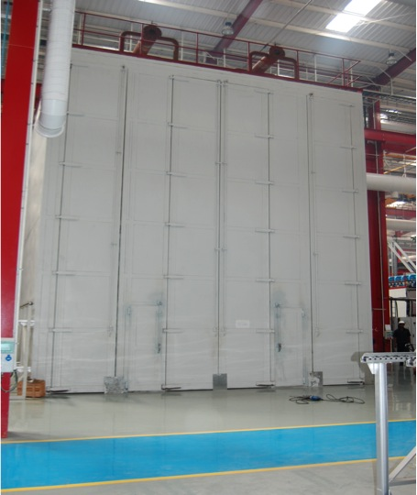

Slide 13
OVEN MADE BY ENCON FOR TATA MOTORS

Slide 14
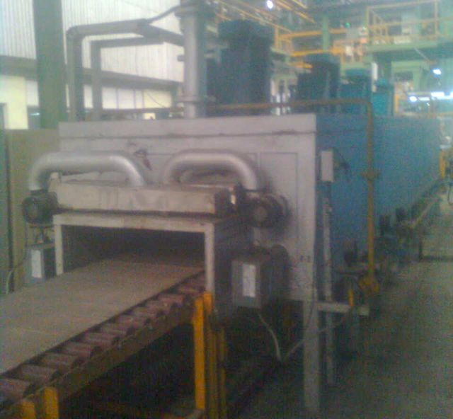

Slide 15
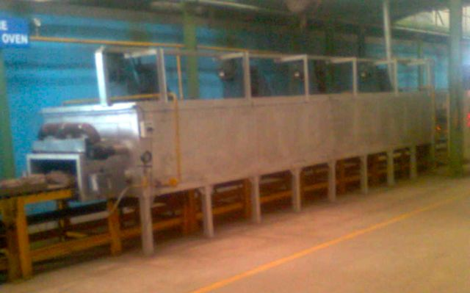

Slide 16
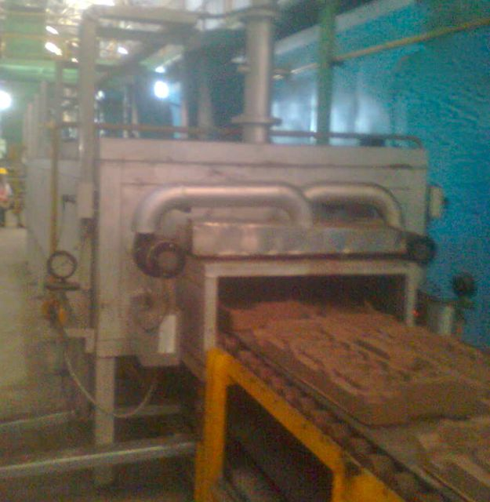

Slide 17
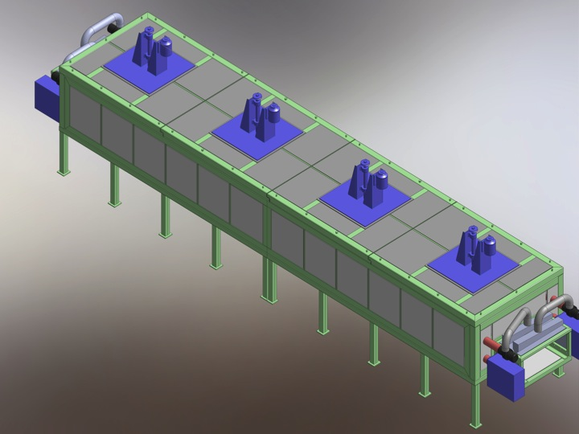

Slide 18
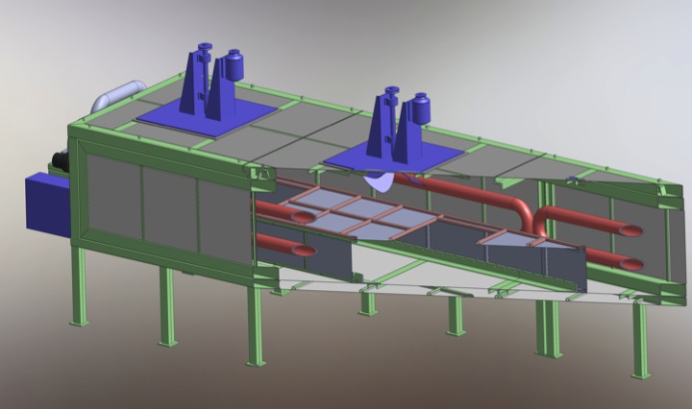

Slide 19
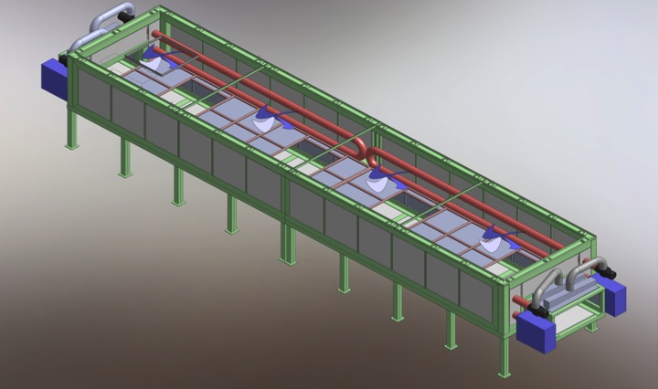

Slide 20
DIAGNOSTIC STUDIES
FURNCES
OVENS
INDUSTRIAL THERMAL APPLICATIONS

Slide 21
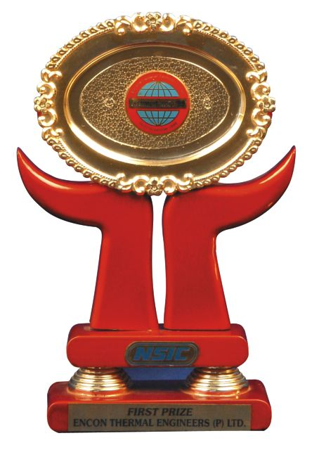
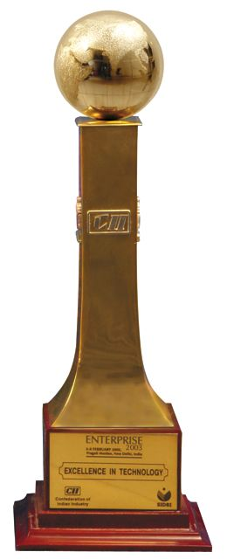
RAD-HEAT GAS HEATING ELEMENTS
Retrofitted in many applications which use Electrical Heaters, Thermic fluid up to a temperature of 550 ºC
Savings from 30% - 70%
‘BEST TECHNOLOGY' award from NSIC
'EXCELLENCE IN TECHNOLOGY' award from CII -SIDBI

Slide 22
SOME OF OUR ESTEEMED CLIENTS
Aarti Steel Limited
ABB Limited
AREVA Instrument
Bajaj Auto Limited
B.H.E.L
Bhushan Steel Limited
Cummins India Limited
Danielli India Limited
Divya Yog Pharmacy
Electrotherm (I) Limited
Exide
Godrej & Boyce Mfg. Co. Limited
Hyderabad Industries Limited
Ispat Industries Limited
Jindal Strips Limited
Kajaria Ceramics Limited
L.G. Electronics Limited
LLOYDS Steel Industries Limited
Mahavir Aluminium Limited
MUKAND Limited
NALCO
Orient Abrasives Limited
Ramco Group of Industries
RHI Clasil Limited
Samtel Color Limited
SHAH Alloys Limited
Shriram Pistons & Rings Limited
SIMPLEX Castings Limited
SISCOL
Tata Motors Limited
Tata Steels Limited
Usha Martin Industries

Slide 23
THANK YOU!
“ Adopt eco-friendly technologies that your children can be proud of ”
Vishve Bandhu Mahendra

